Slide 1

Smart Automated Interviewing System using Gesture Analysis & NLP
Group Members Roll # CGPA
Tooba Nizami CS-19101 3.22
Wania Siddiqui CS-19120 2.819
Moiz Ali CS-19087 3.62
Uzair Farooqui CS-19143 2.15

Slide 2
Task Distribution
Members | Contributions
Moiz Ali | Data Collection & Preprocessing , Steps of NLP, Model Selection & Development, Report Writing.
Wania Siddiqui | Data Collection & Preprocessing , Creating the Question Bank, Research for ML Models, Report Writing, Presentation.
Tooba Nizami | Exploration of Tools, Gesture Selection , Develop Algorithm for Tracking Gesture, Testing of developed model , Report Writing, Presentation.
Uzair Farooqui | Exploration of Tools, Research work related to gesture analysis

Slide 3
Smart Automated Interviewing System
Background
New variations in technology are changing and personalizing the way humans interact with computers, and this is rapidly changing what survey researchers need to consider as they design the next generation of interviewing technologies.
Project Introduction
Smart Automated System can conduct Interviews in Real-time, it dynamically analyses and evaluates the answer responses using Natural Language Processing.
The system also detects the gesture of the candidate and check in-confidence level to determine the score.

Slide 4
Flow of the Project
User Authentication
Gesture Analysis
Q/A Session
Scoring
Analyzes the answer using NLP
Maintain database & finalize candidates
Filtering Selected Candidates
Pass it to HR

Slide 5
Smart Interviewing System
Natural Language Processing
Gesture Analysis
Data Collection & Preprocessing
Create Question Bank
Study steps of NLP
Research for ML Models
Model Selection
Study Architecture of the Model
Development/Coding of Model
Testing
Integration
Explore tools for Gesture Analysis
Gesture Selection
Algorithm to Track the Gesture
Image Processing
Scoring on the basis of results from Analysis
Development & Testing

Slide 6
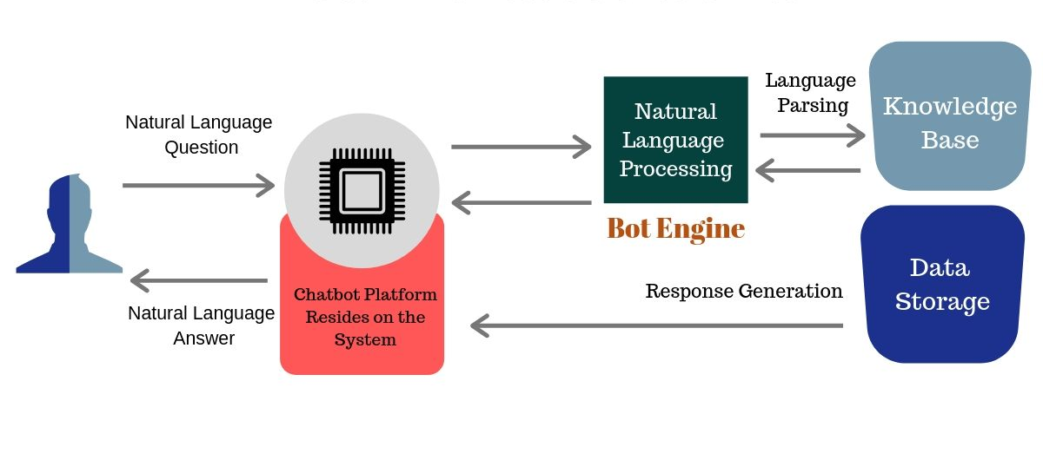
How does the NLP model work ?

Slide 7
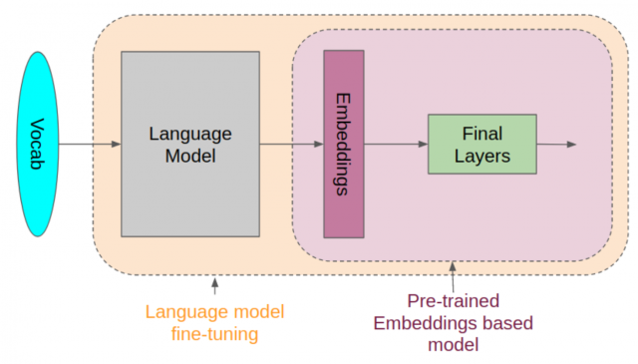
Natural Language Processing Models
We have selected the most popular NLP model for machine learning that is ‘BERT’. BERT is a pre-trained model that uses both the left and right sides of a word to determine its context. BERT heralds a new age in NLP because, despite its precision, it is built on two simple concepts.

Slide 8
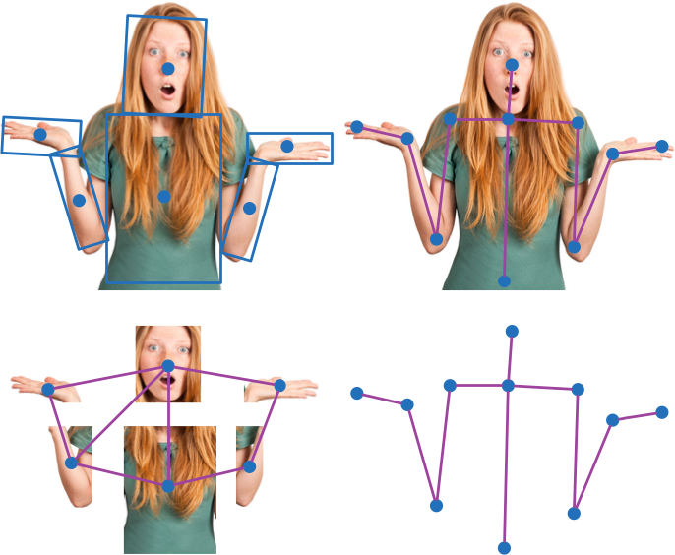
Gesture Analysis

Slide 9
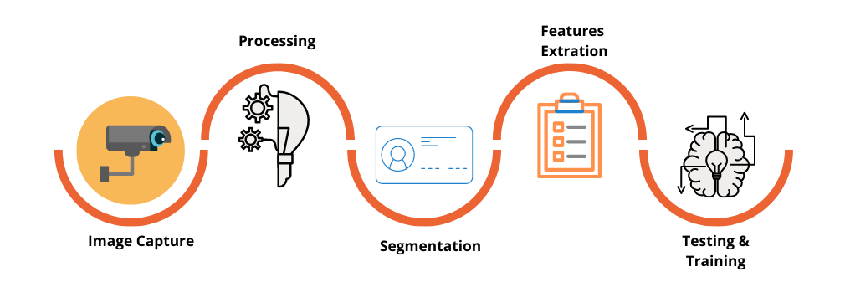
Gesture Analysis
Next phase of Gesture Analysis is Image Processing

Slide 10
Milestones Achieved
Summary

Slide 11
Smart Interviewing System
Natural Language Processing
Gesture Analysis
Data Collection & Preprocessing
Create Question Bank
Study steps of NLP
Research for ML Models
Model Selection
Study Architecture of the Model
Development
Testing
Integration
Phase Complete
Explore tools for Gesture Analysis
Gesture Selection
Algorithm to Track the Gesture
Image Processing
Scoring on the basis of results from Analysis
Development & Testing
Next phase

Slide 12
Future Plan
We are aiming to do step into the next phase:
Modify & develop the architecture of NLP model
Testing of the model
Image processing on the Real time images captured
Score Calculation
Development & testing of the Gesture detection model

Slide 13
Thankyou

